Slide 1
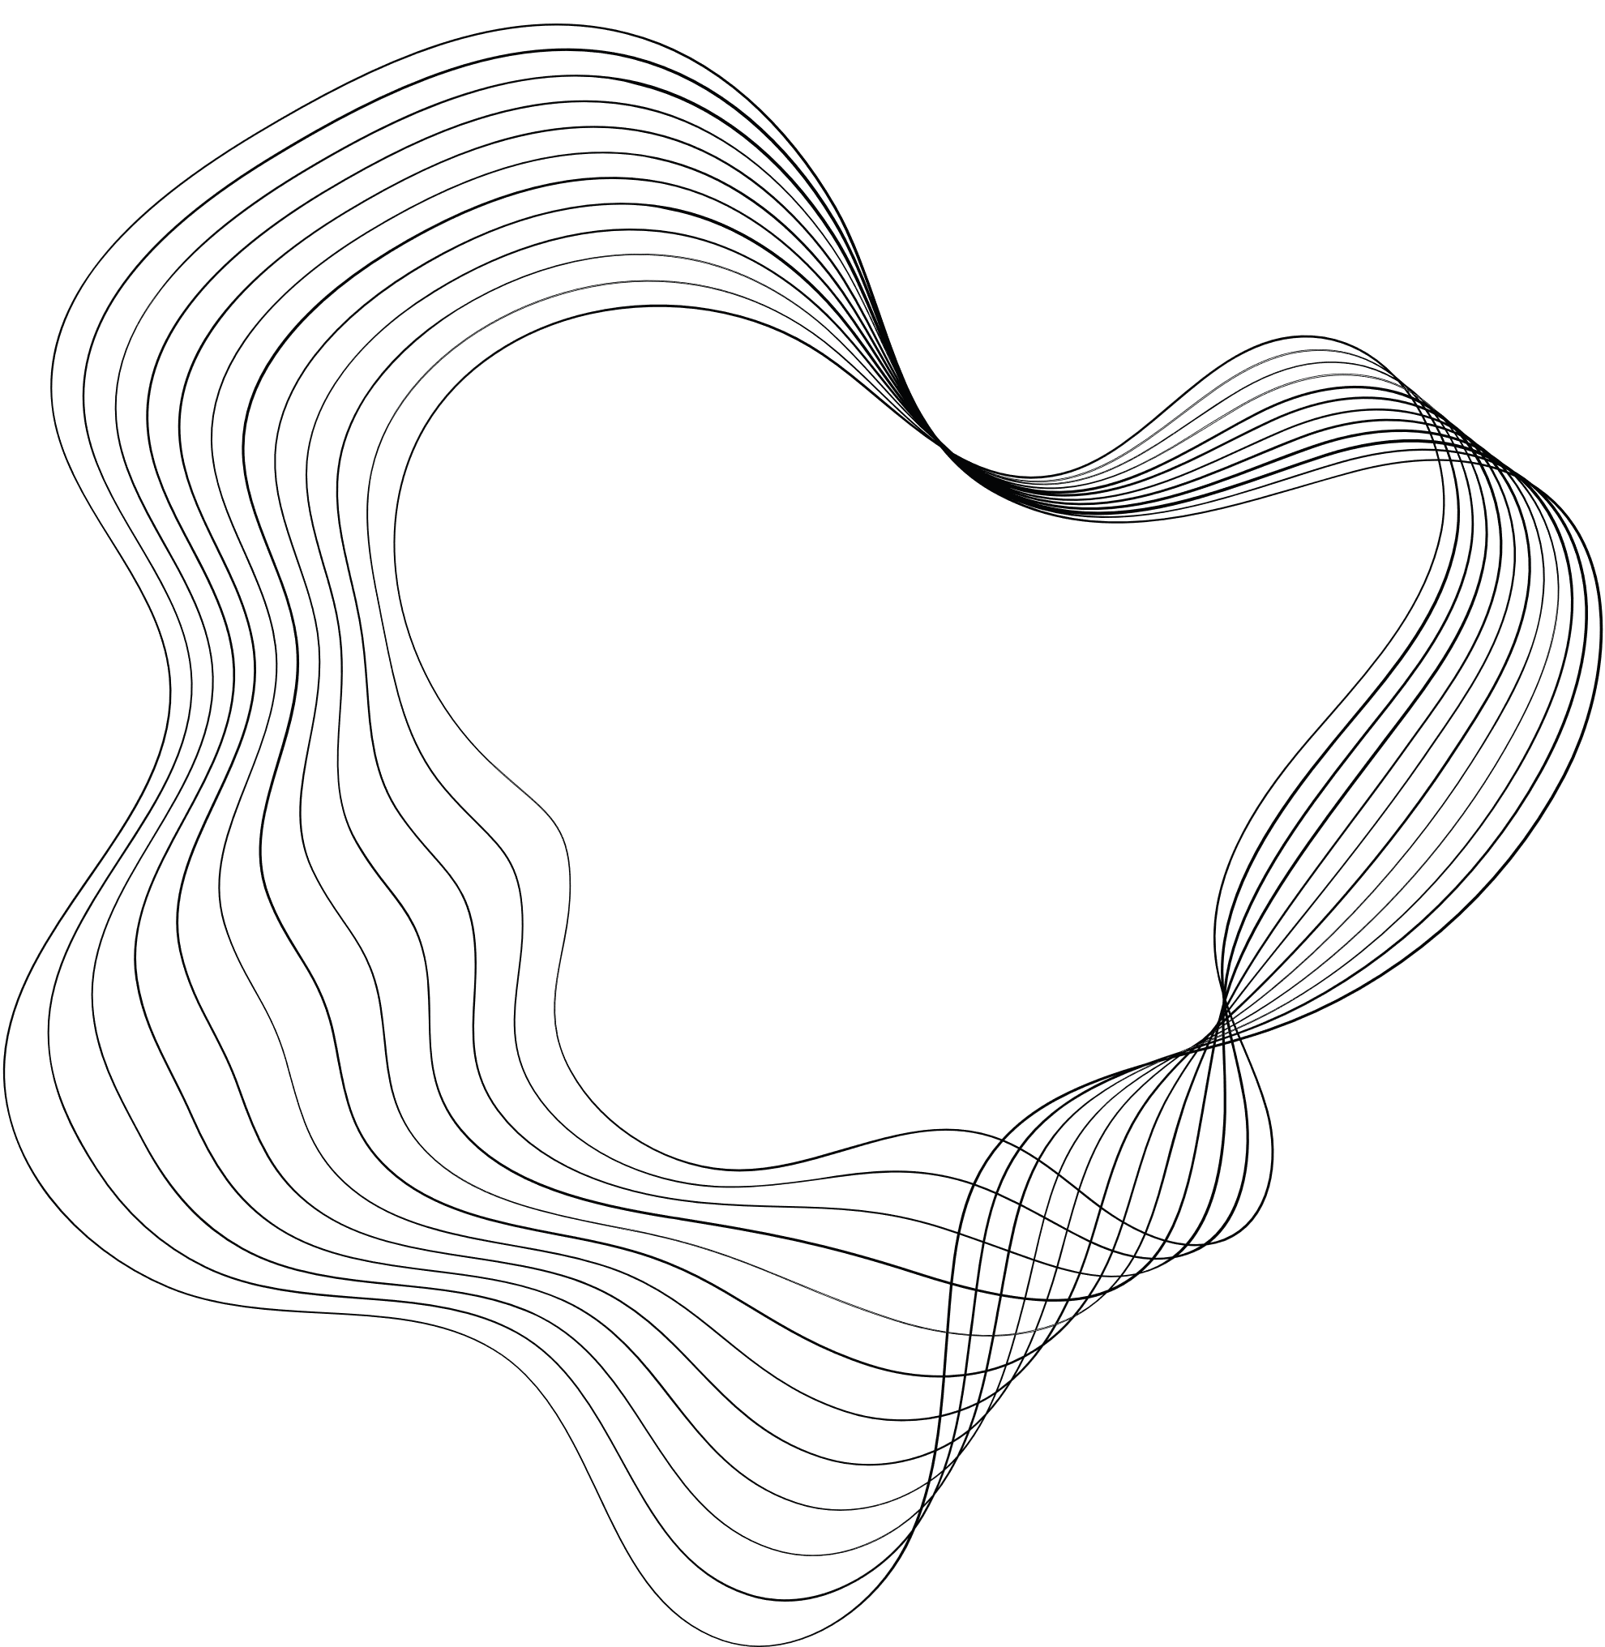

SIEM & XDR PROTECTION FOR ENDPOINTS WITH WAZUH

Slide 2

CONTENT
01
INTRODUCTION
02
TECHNOLOGIES
03
ARCHITECTURE
04
DEMO

Slide 3



01. INTRODUCTION
Wazuh is a free, open-source security platform that unifies the features of XDR and SIEM. It protects workloads across on-premise, virtualization, container, and cloud environments.
Wazuh can be deployed on different operating systems such as Windows, Linux, macOS, and many virtualization platforms.

Slide 4

01. INTRODUCTION
Objective: Deploy Wazuh-XDR along with tools such as Snort, Mod Security, Suricata, and ELK stack to monitor, detect, and respond to incidents on the network model being protected.

Slide 5
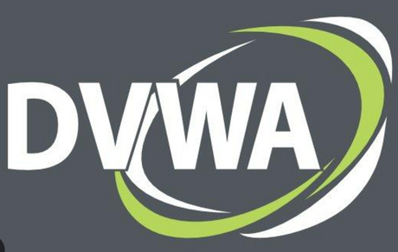

02. TECHNOLOGIES
DVWA: Damn Vulnerable Web Application is a web application that contains a security vulnerability, which is used to practice web application security skills.
Mod Security: The powerful WAF tool, which helps protect web applications from attacks and security threats, and provides monitoring and activity logging.

Slide 6


02. TECHNOLOGIES
Suricata and Snort: The powerful and flexible IDPS tools widely used to monitor, detect, and prevent abnormal or offensive network activities.
ELK stack: The toolkit includes Elasticsearch, Logstash, and Kibana, which are capable of collecting, transforming, storing, searching, and analyzing log data.

Slide 7
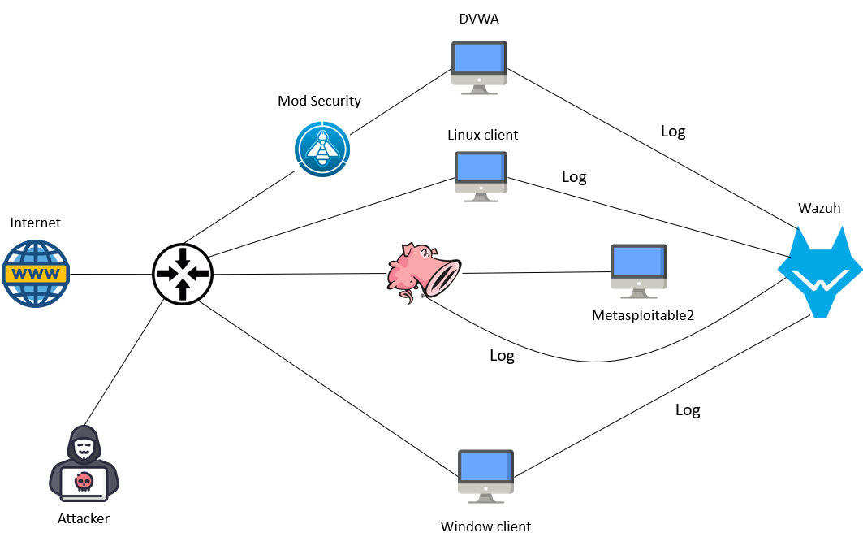
03. ARCHITECTURE

Slide 8

04. DEMO

Slide 9
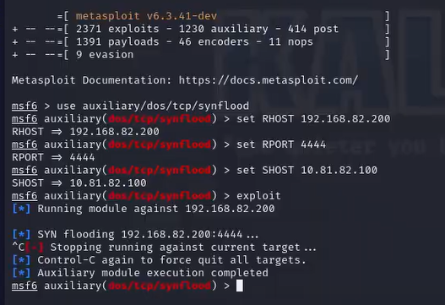
1.CHECK THE PUSH LOG ACTIVITY TO THE WAZUH SERVER
Perform a SYN flood attack on a metasploitable machine supervised by Snort.

Slide 10
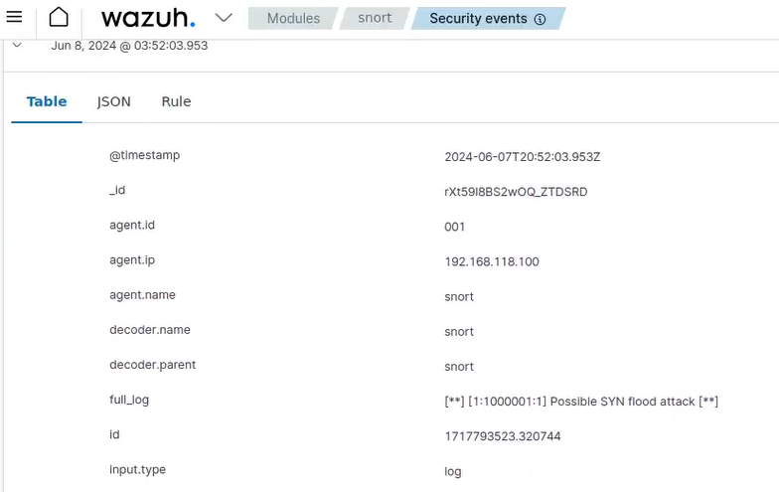
1.CHECK THE PUSH LOG ACTIVITY TO THE WAZUH SERVER
Information about the attack is logged and displayed in the dashboard of the Wazuh server.

Slide 11
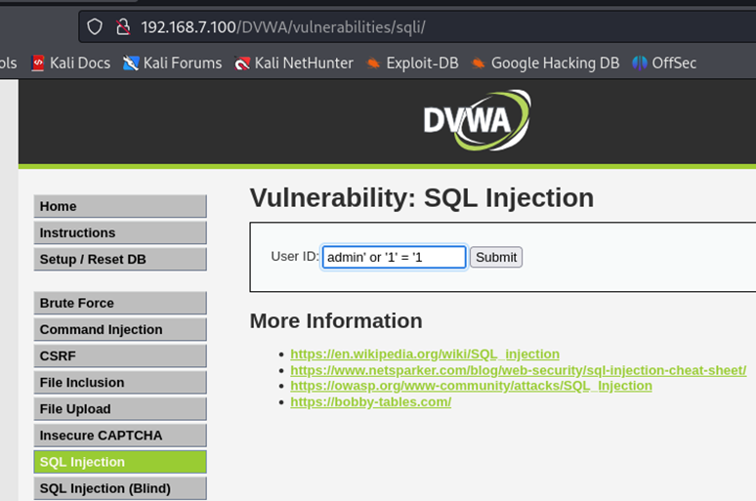
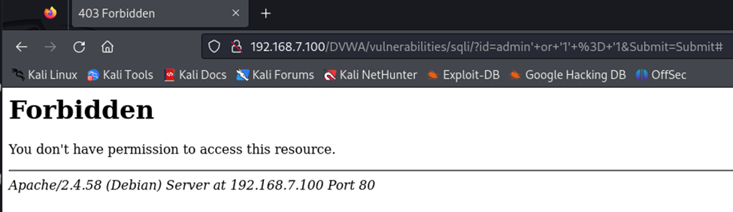
1.CHECK THE PUSH LOG ACTIVITY TO THE WAZUH SERVER
Perform a SQL Injection attack on a machine that installs DVWA. This attack is blocked and logged by Mod Security.

Slide 12
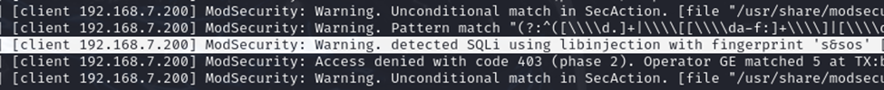
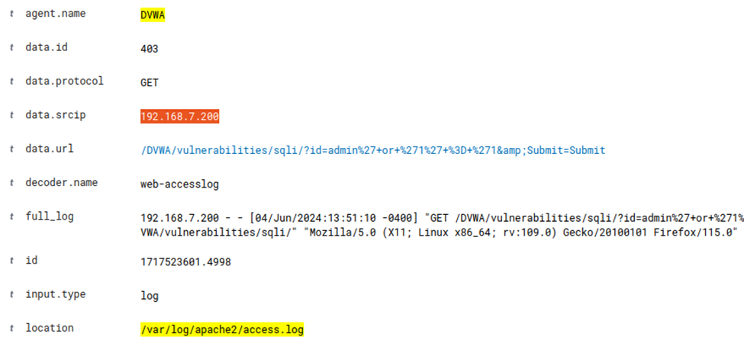
1.CHECK THE PUSH LOG ACTIVITY TO THE WAZUH SERVER
Logs on Mod Security are pushed to the dashboard of Wazuh Server.

Slide 13
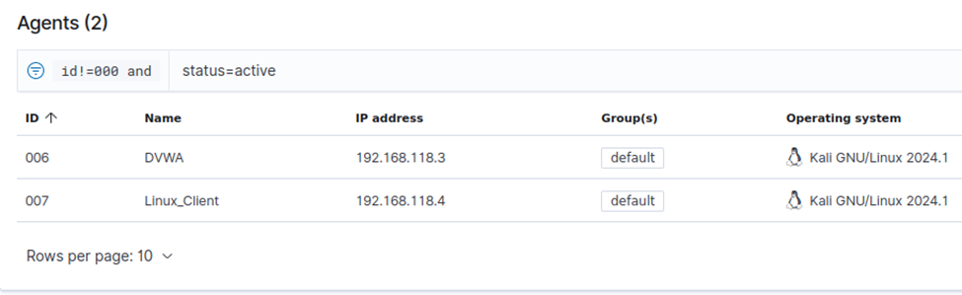
2. BLOCK DVWA ACCESS FROM NON-AGENT MACHINES
Configure Mod Security rules to ensure that only machines with the Wazuh agent installed can access the DVWA web resource.
Linux client and DVWA machines with Wazuh agent installed.

Slide 14
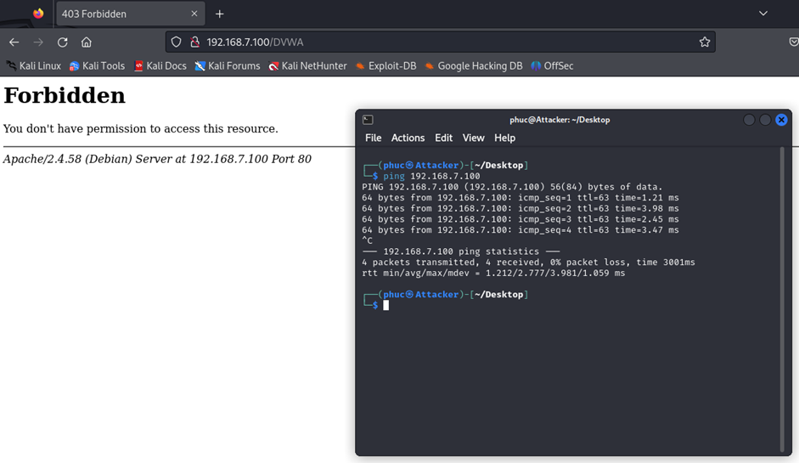
2. BLOCK DVWA ACCESS FROM NON-AGENT MACHINES
The attacker can ping the DVWA machine but cannot access the web resource

Slide 15
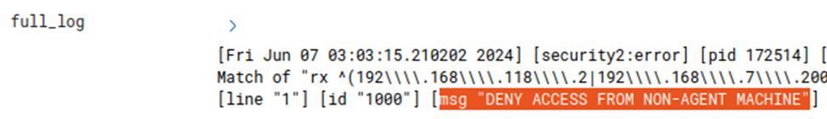
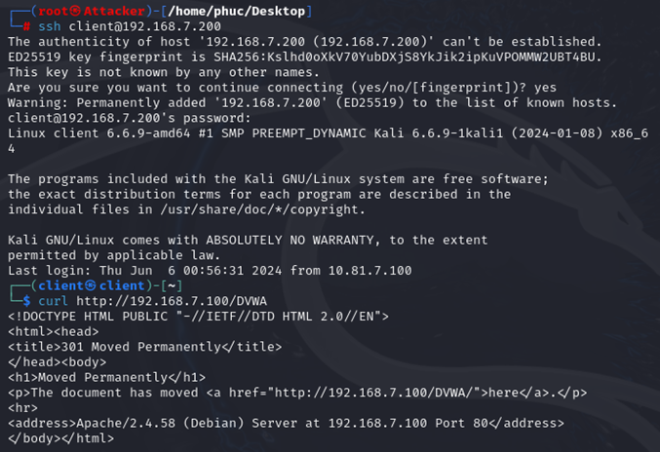
2. BLOCK DVWA ACCESS FROM NON-AGENT MACHINES
Logs alert about the access of the machine without the agent attached
The attacker can only access DVWA by connecting to the client via SSH

Slide 16
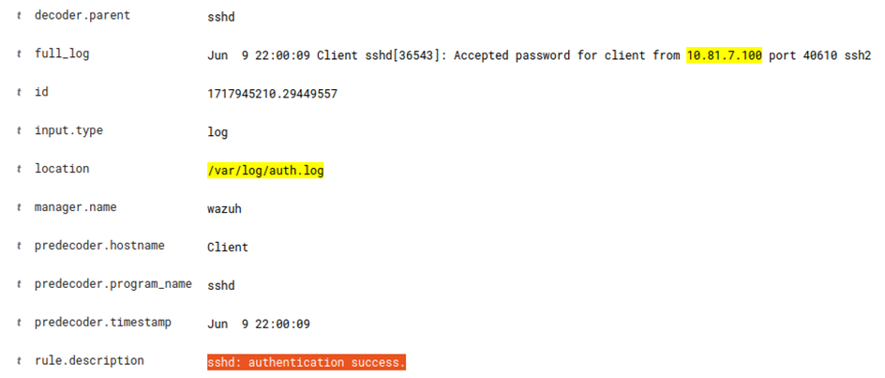
2. BLOCK DVWA ACCESS FROM NON-AGENT MACHINES
The attacker's SSH connection is also logged, we can trace the attacker's IP as 10.81.7.100

Slide 17
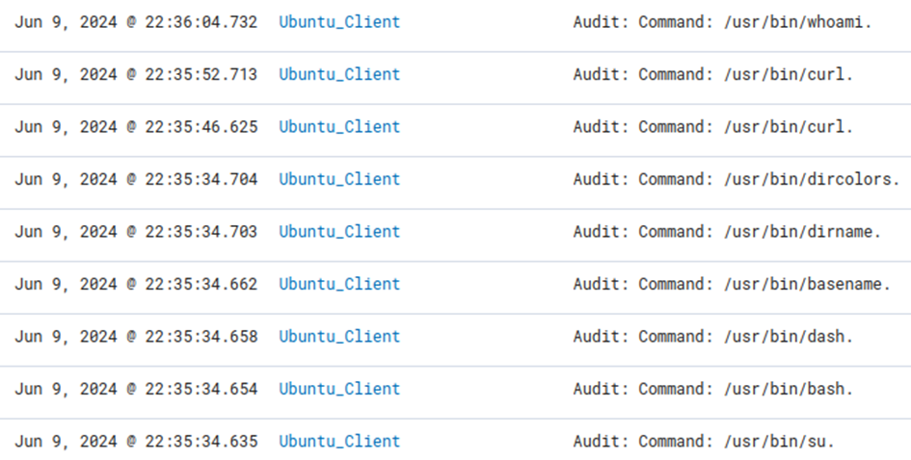
3. MONITORING LINUX COMMANDS ON AGENT MACHINES
Track all orders executed on the agent machine through the auditd tool
Log commands from the system running in the background, OS, system health check

Slide 18
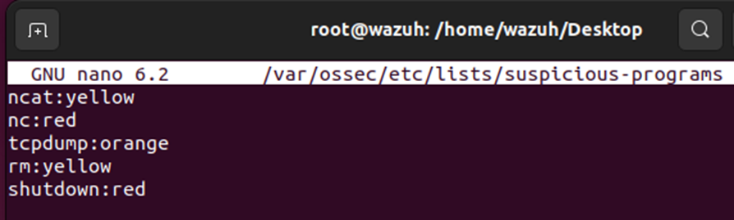
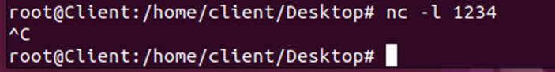
3. MONITORING LINUX COMMANDS ON AGENT MACHINES
Customize the ossec configuration to create a list of suspicious commands, Wazuh will alert you specifically if the agent executes these commands
Try executing the netcat command

Slide 19
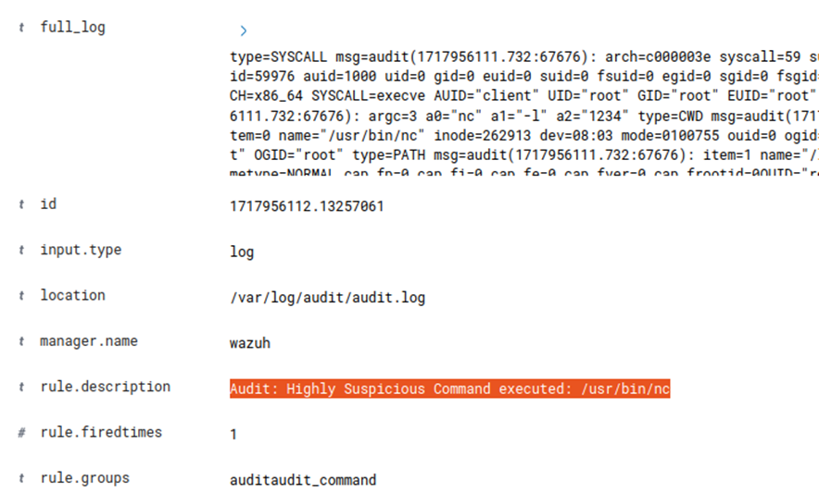
3. MONITORING LINUX COMMANDS ON AGENT MACHINES
Result

Slide 20
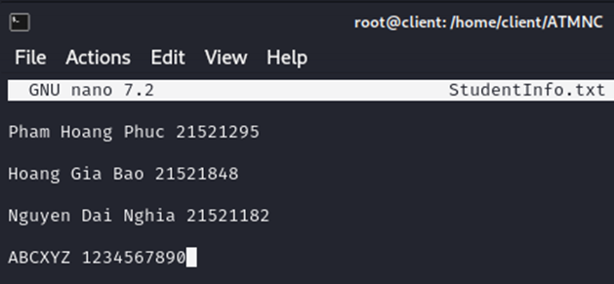
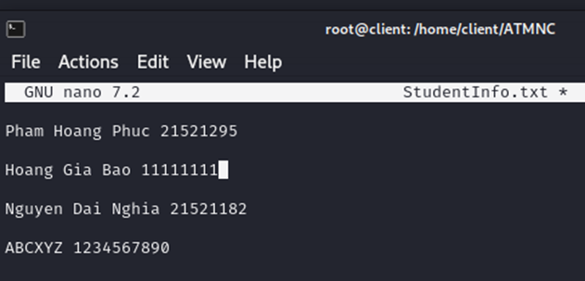
4. FILE INTEGRITY MONITORING (FIM)
Track changes to files in the folder
For example, in the ATMNC folder, there is 1 StudentInfo file containing student information
Edit the file

Slide 21
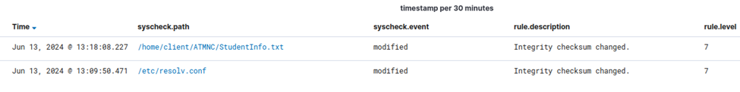
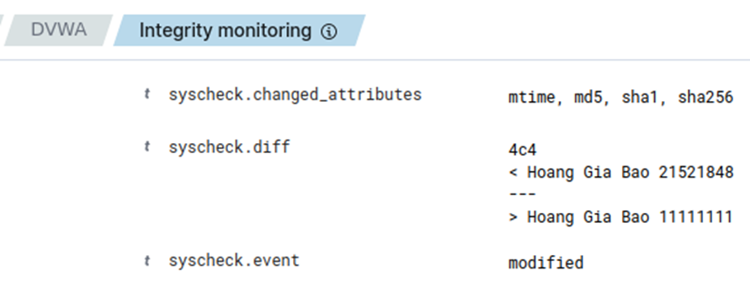
4. FILE INTEGRITY MONITORING (FIM)
Check alert from Wazuh dashboard
Edits in the file have been logged

Slide 22
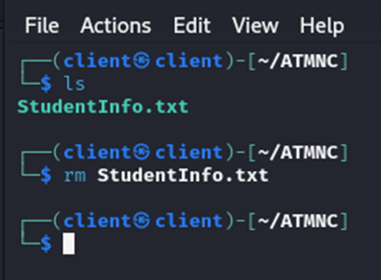
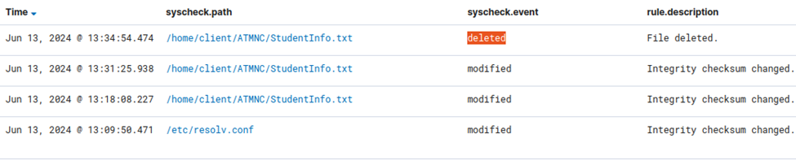
4. FILE INTEGRITY MONITORING (FIM)
Delete file
File deletion is logged and sent to Wazuh's dashboard

Slide 23
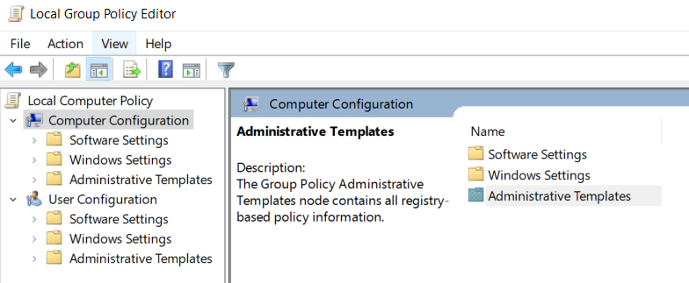
5. MONITOR CMD COMMAND ON WINDOWS
Visit Local Group Policy Editor -> Computer Configuration -> administrative Templates

Slide 24
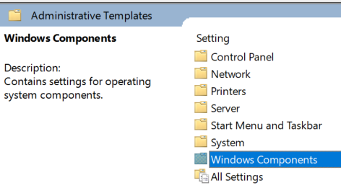
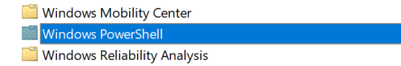
5. MONITOR CMD COMMAND ON WINDOWS
Continue to access Windows Components -> Windows PowerShell

Slide 25
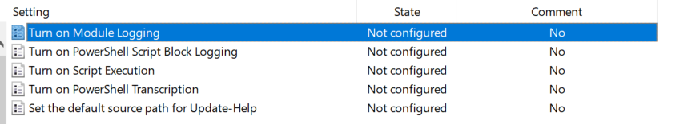
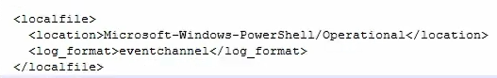
5. MONITOR CMD COMMAND ON WINDOWS
Turn on Mondule Logging and Turn on PowerShell Transcription
Configuring the ossec.conf file on the Windows client

Slide 26
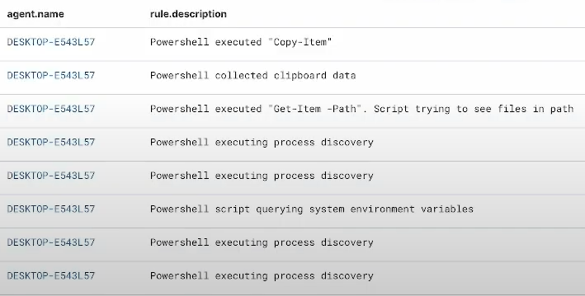
5. MONITOR CMD COMMAND ON WINDOWS
PowerShell commands on Windows client machines have been logged (including commands executed by the system in the background)

Slide 27
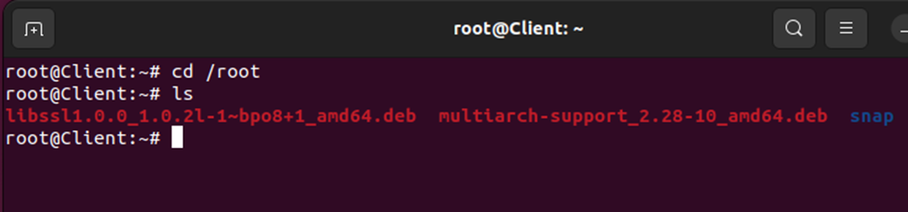
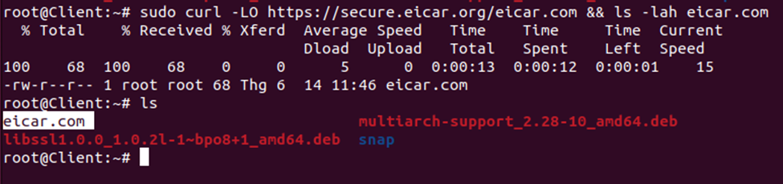
6. VIRUSTOTAL INTEGRATION
Built-in VirusTotal to detect malicious files and combined with Wazuh's active-response feature to remove malicious files
The tracking object is the /root directory on the Linux client machine.
Installing malicious files

Slide 28
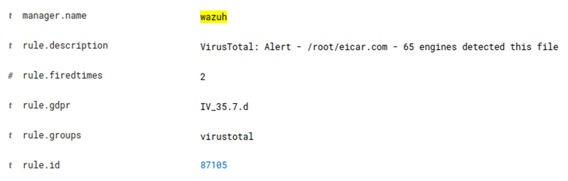
6. VIRUSTOTAL INTEGRATION
VirusTotal detected the malicious file and sent a warning to the Wazuh server

Slide 29
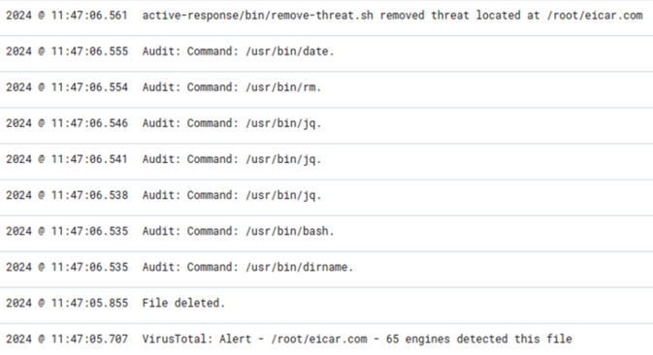
6. VIRUSTOTAL INTEGRATION
After detection, the Linux client automatically deleted the malicious file and sent alerts to the Wazuh dashboard

Slide 30

THANKS FOR WATCHING

